Slide 1
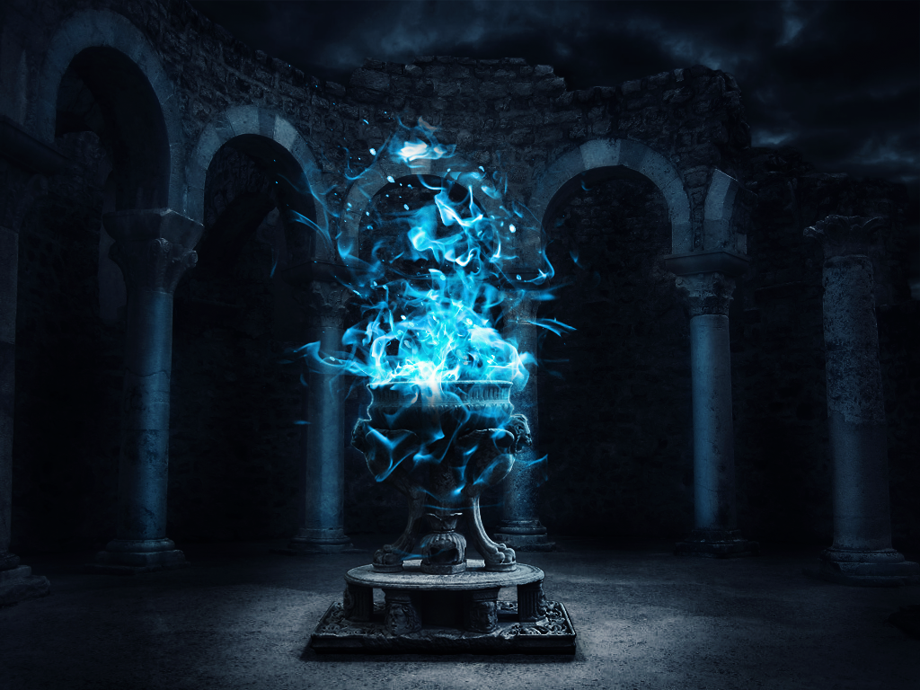
Harry Potter & The Goblet of Fire
Billington
4th 9 Weeks Project

Slide 2
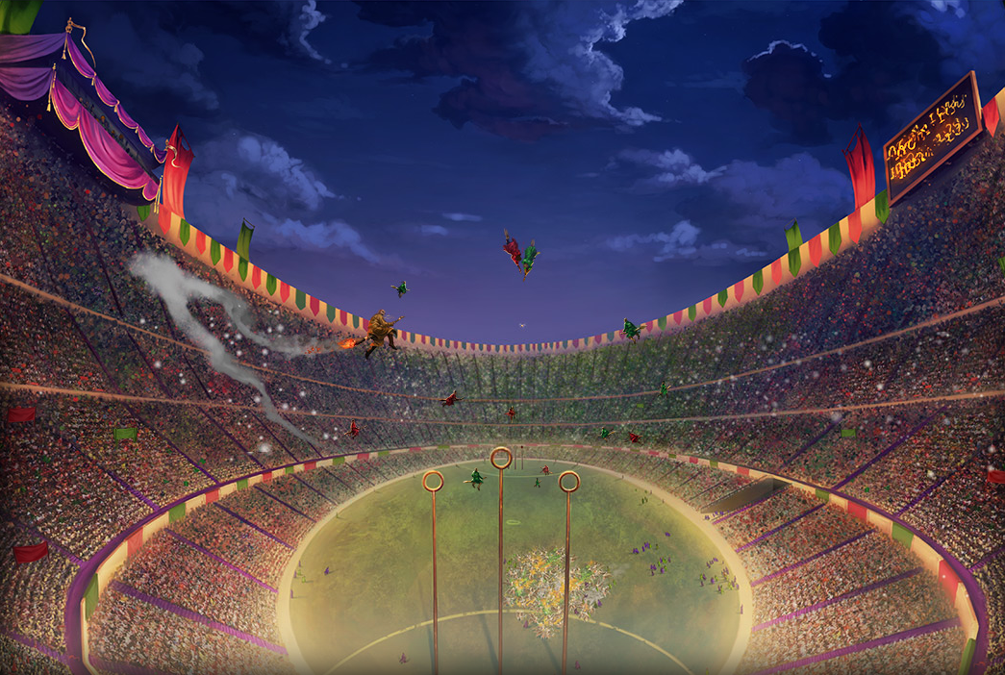
QUIDDITCH WORLD CUP

Slide 3
